Slide 1
Shawshank Redemption
October XX, 20XX
A Story About Hope and Perseverance

Slide 2
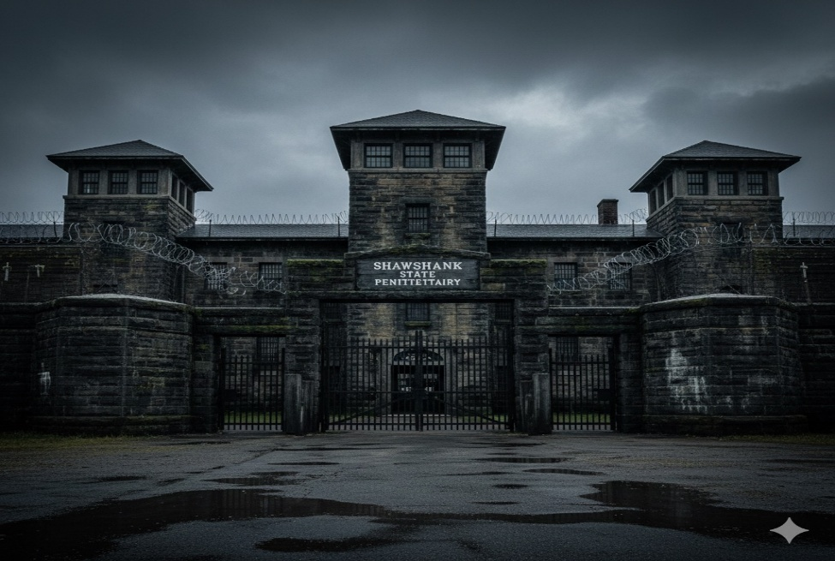
Group Introduction
Group Introduction
- Group Name: Wizards
- Nafisa Ahmed – 2511292038
- Raisa Hossain – 2511346038
- Zannatul Mawa Bushra – 2511255038
- Md. Rasheduzzaman – 2511254038
- Raihan Shorif Ruhdro – 251872038
“Good morning everyone. We are Group Wizards and we are here to present a review of the movie The Shawshank Redemption.”

Slide 3
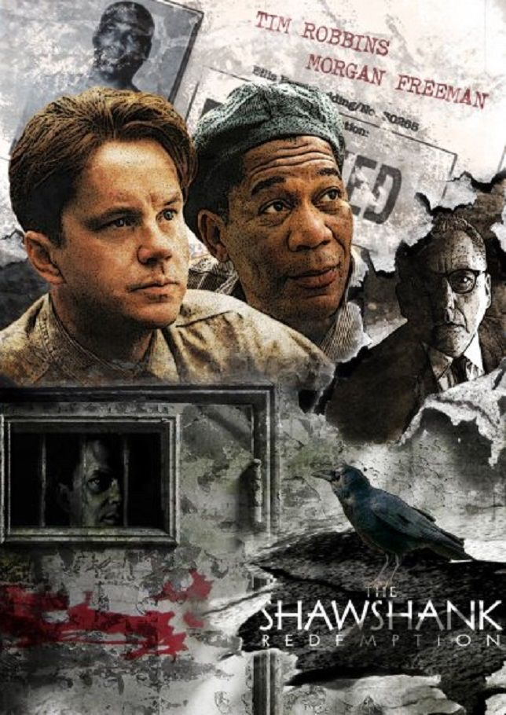
Introduction
This presentation explores The Shawshank Redemption, a powerful movie that inspires hope and resilience. Well see what makes this film so special, why it resonates with many, and the meaningful messages it shares about never giving up.

Slide 4

01
Movie Introduction

Slide 5

Title and Overview
The Shawshank Redemption is a drama film directed by Frank Darabont, released in 1994. It tells the story of Andy Dufresne, a man wrongfully imprisoned, and his journey through hardship. The movie blends drama and deep emotional themes, drawing viewers into a tale of friendship and survival against all odds.

Slide 6
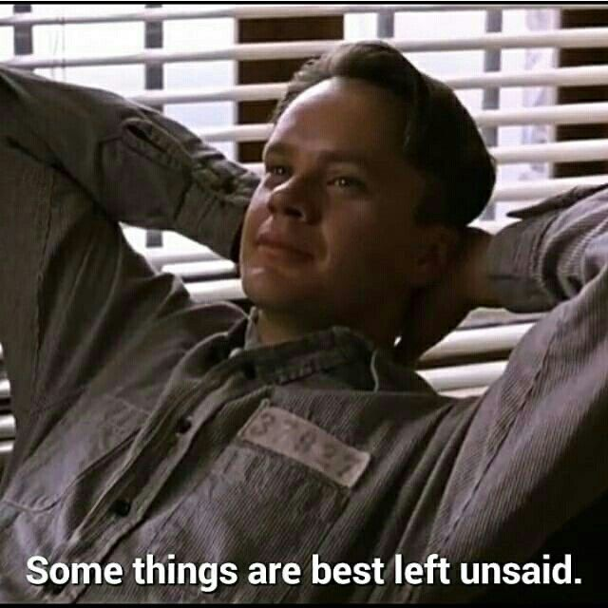
Director, Year, Genre
Directed by Frank Darabont, this 1994 classic falls into the drama genre. It’s widely praised for its storytelling, character development, and inspiring message. The film combines suspense and heartfelt moments, making it a timeless favorite for audiences worldwide.

Slide 7
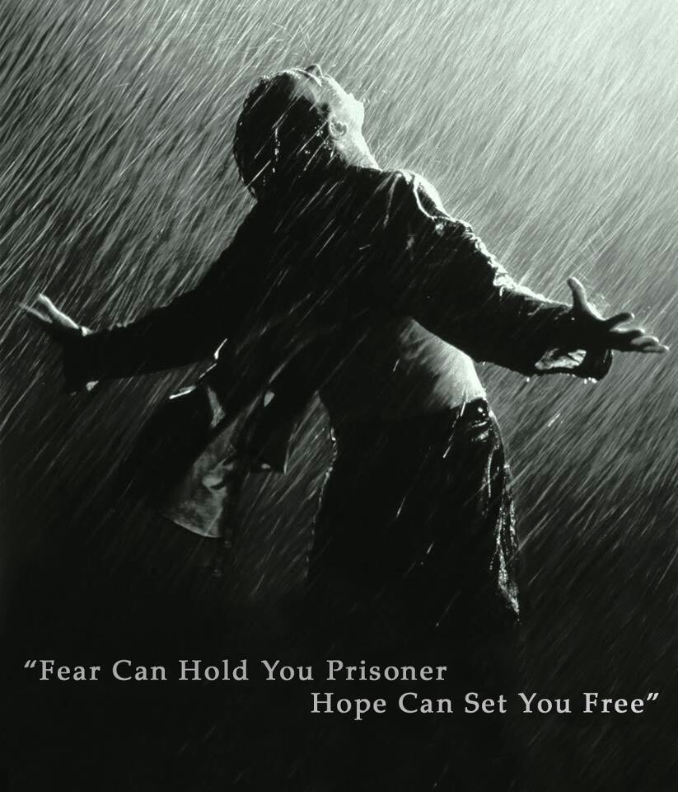
Reason for Choice and Inspirational Message
We chose The Shawshank Redemption because it’s a film full of hope and perseverance. It shows how no matter how tough life gets, holding on to hope can lead to incredible outcomes. The story inspires us to never give up, even in the darkest moments, making it a truly powerful and uplifting movie.

Slide 8
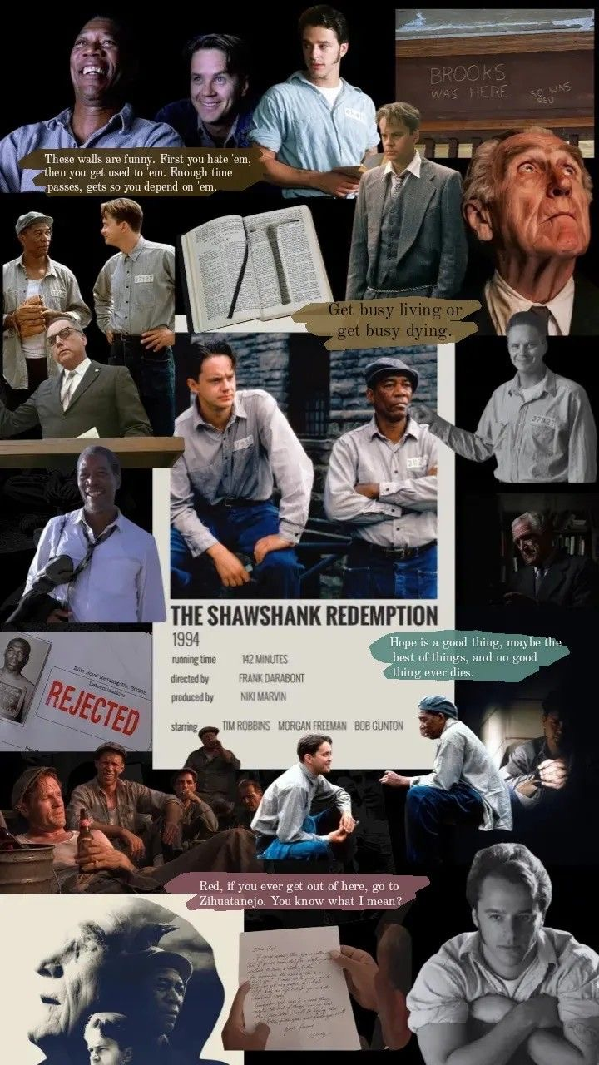
02
Characters and Story

Slide 9
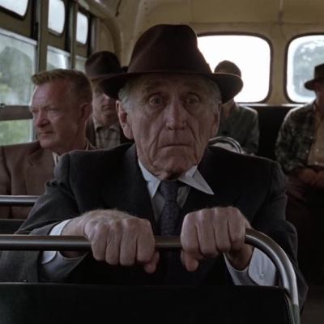
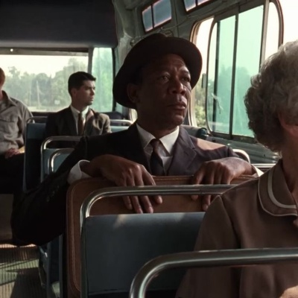
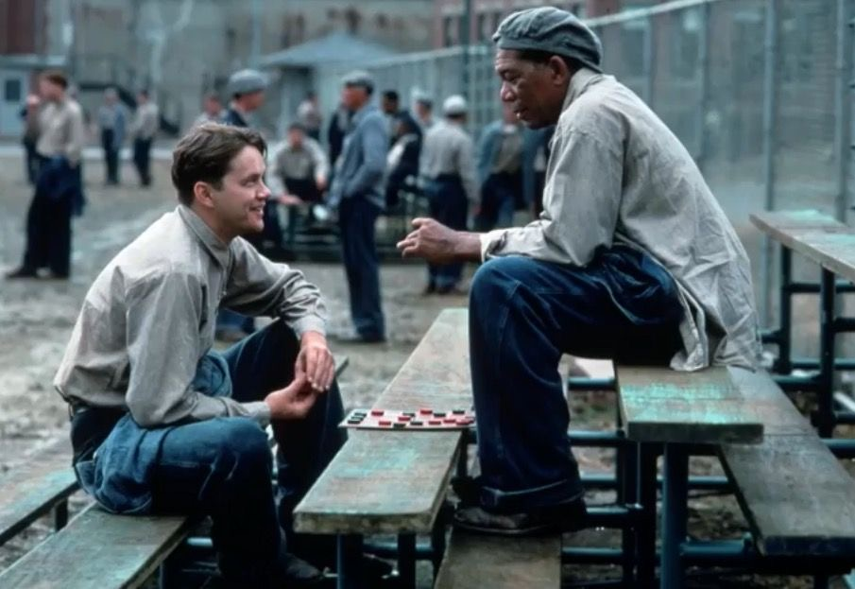
Main Characters and Their Roles
The film features Andy Dufresne, the hopeful and clever main character. Red is his loyal friend and mentor, providing support throughout. Warden Norton is the antagonist, symbolizing corruption and control. Each character plays a crucial role in showing how friendship and resilience help overcome tough situations.

Slide 10
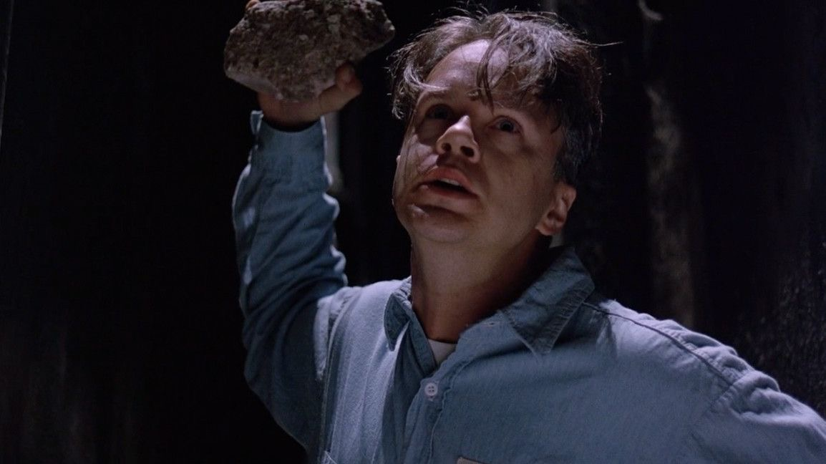
Plot Highlights
Andy is wrongfully imprisoned but never loses hope. He forms a strong friendship with Red and faces many challenges inside prison. Through cleverness and determination, Andy plans and executes a brilliant escape, ultimately finding his redemption and freedom after years of struggle.

Slide 11
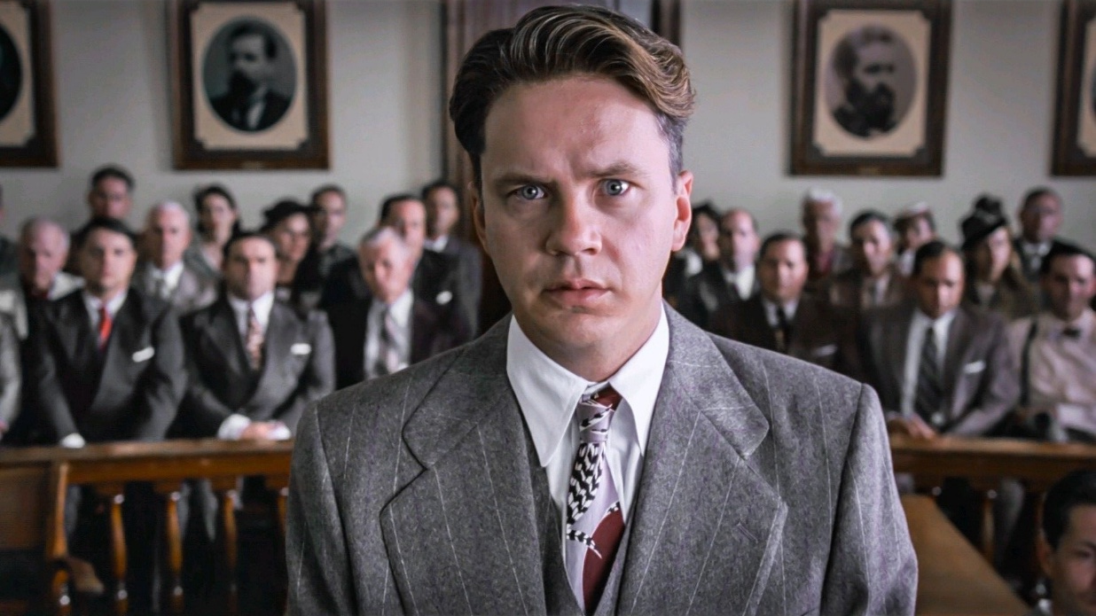
Key Themes and Life Lessons
The movie teaches powerful lessons about hope, perseverance, and the strength of friendship. It shows that loyal bonds and a positive mindset can help overcome even the harshest conditions. The film invites us to believe in second chances and the possibility of freedom beyond our struggles.

Slide 12

Termination
The Shawshank Redemption leaves us with a message that hope and resilience are essential in life. It reminds us that friendship and loyalty help us push through challenges, and that freedom is more than physical—its a state of mind worth fighting for. This movie inspires viewers to keep going, no matter what.

Slide 13
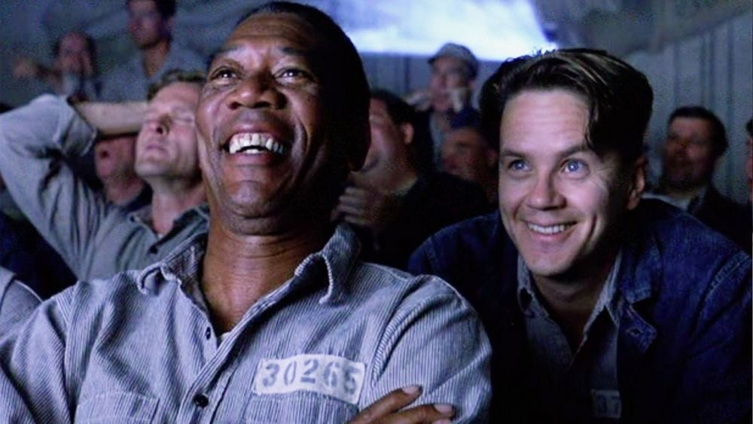
Thanks for your attention
Do you have any questions?
nafisaahmed8522@hotmail.com | +88 016367 68522

